Slide 1
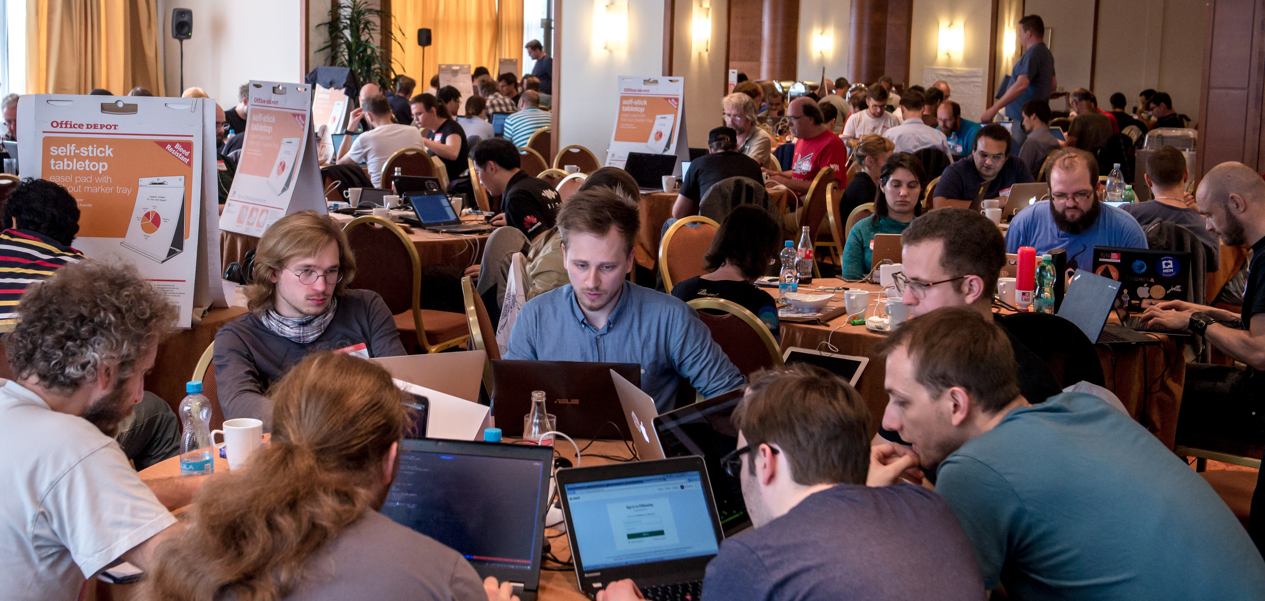
IETF 99 Hackathon

Slide 2
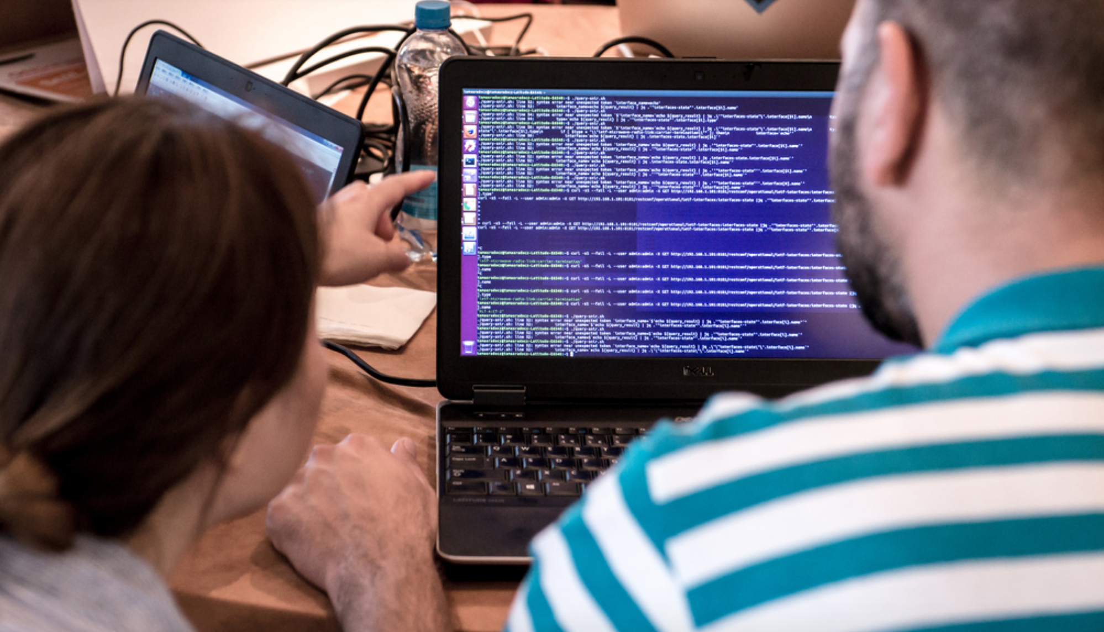
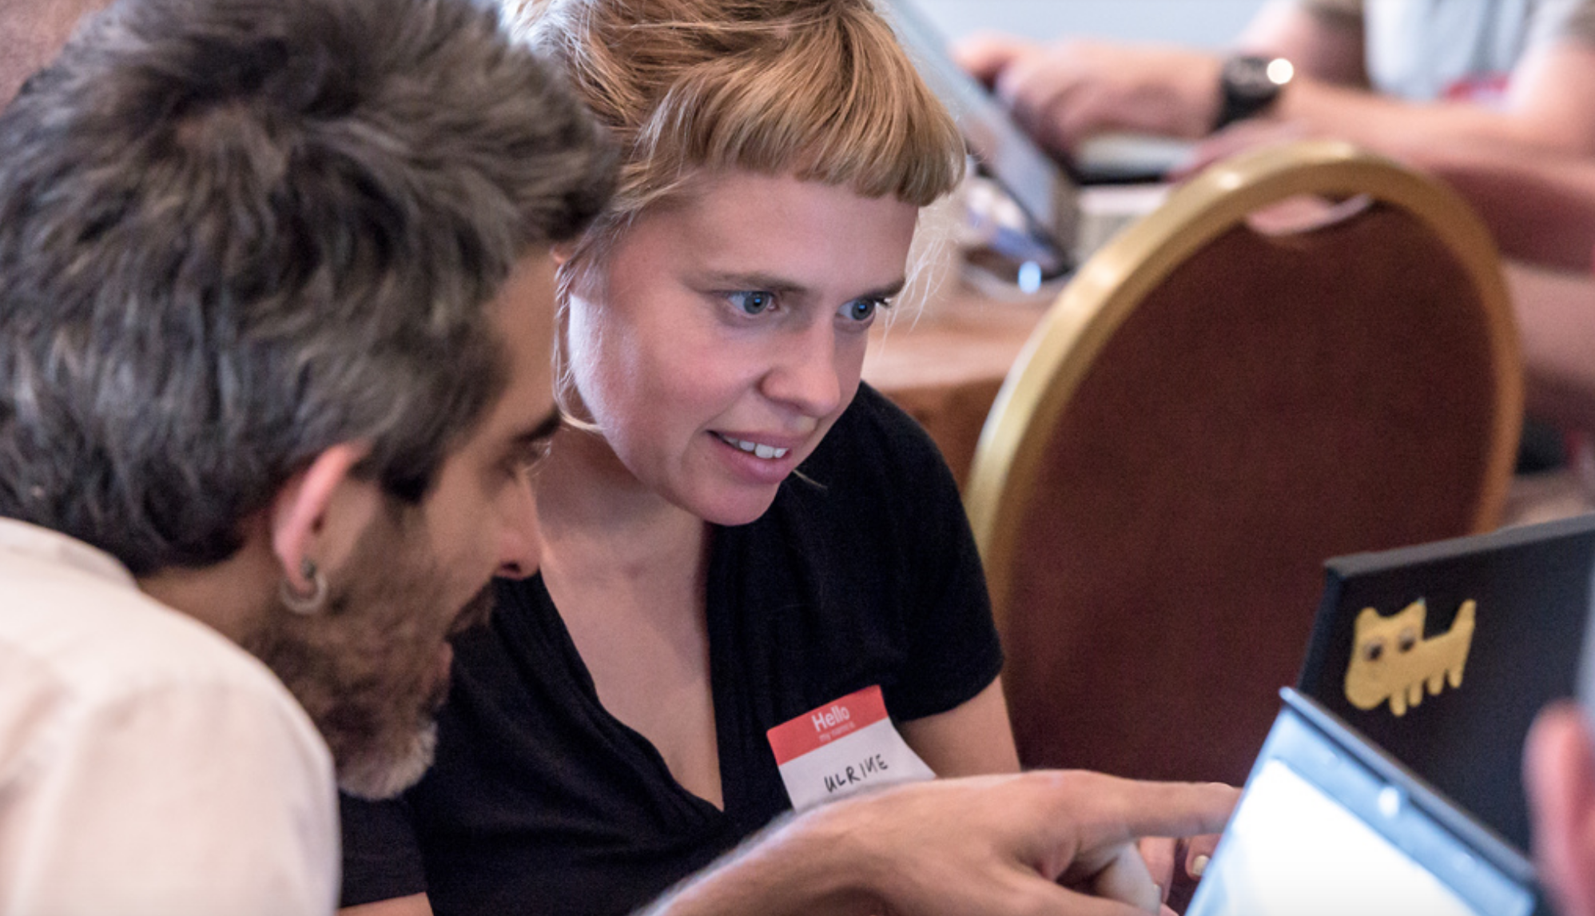
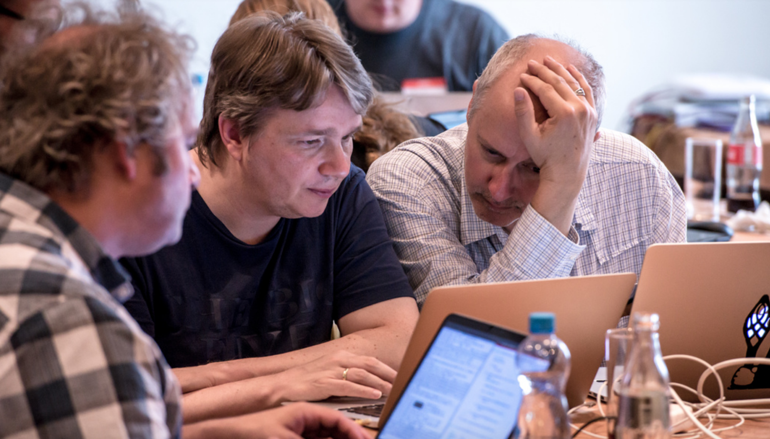
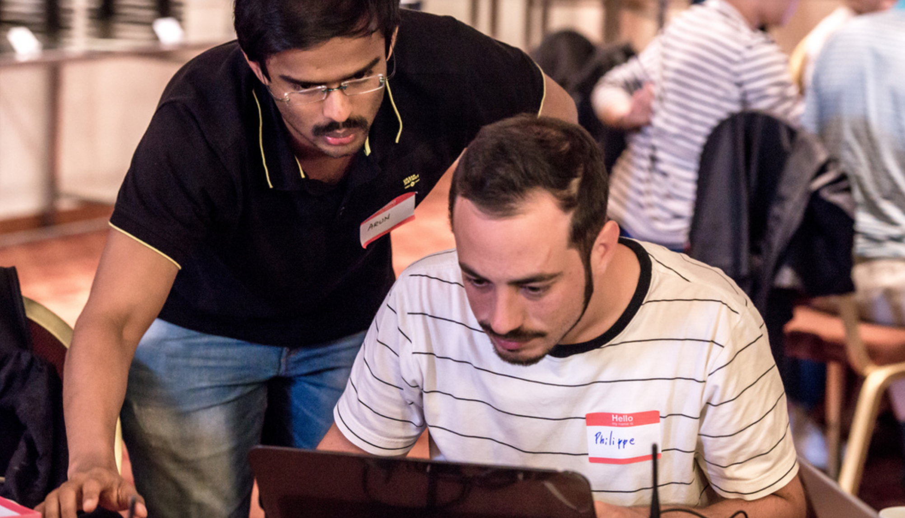
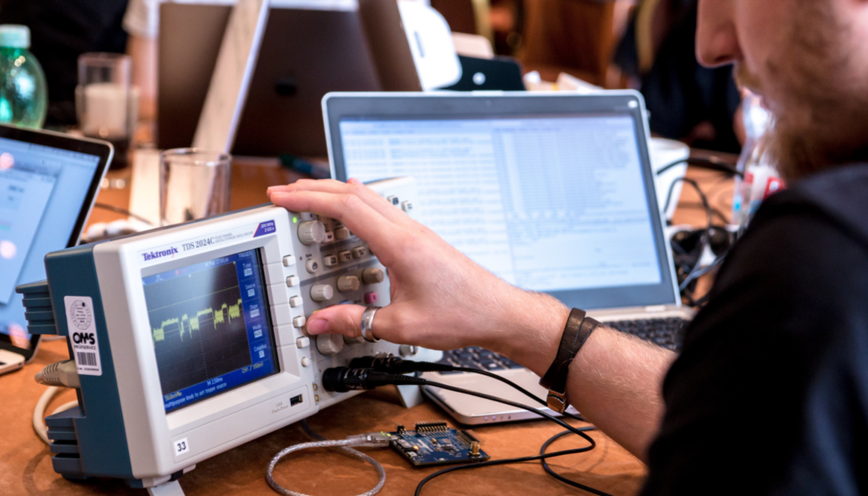
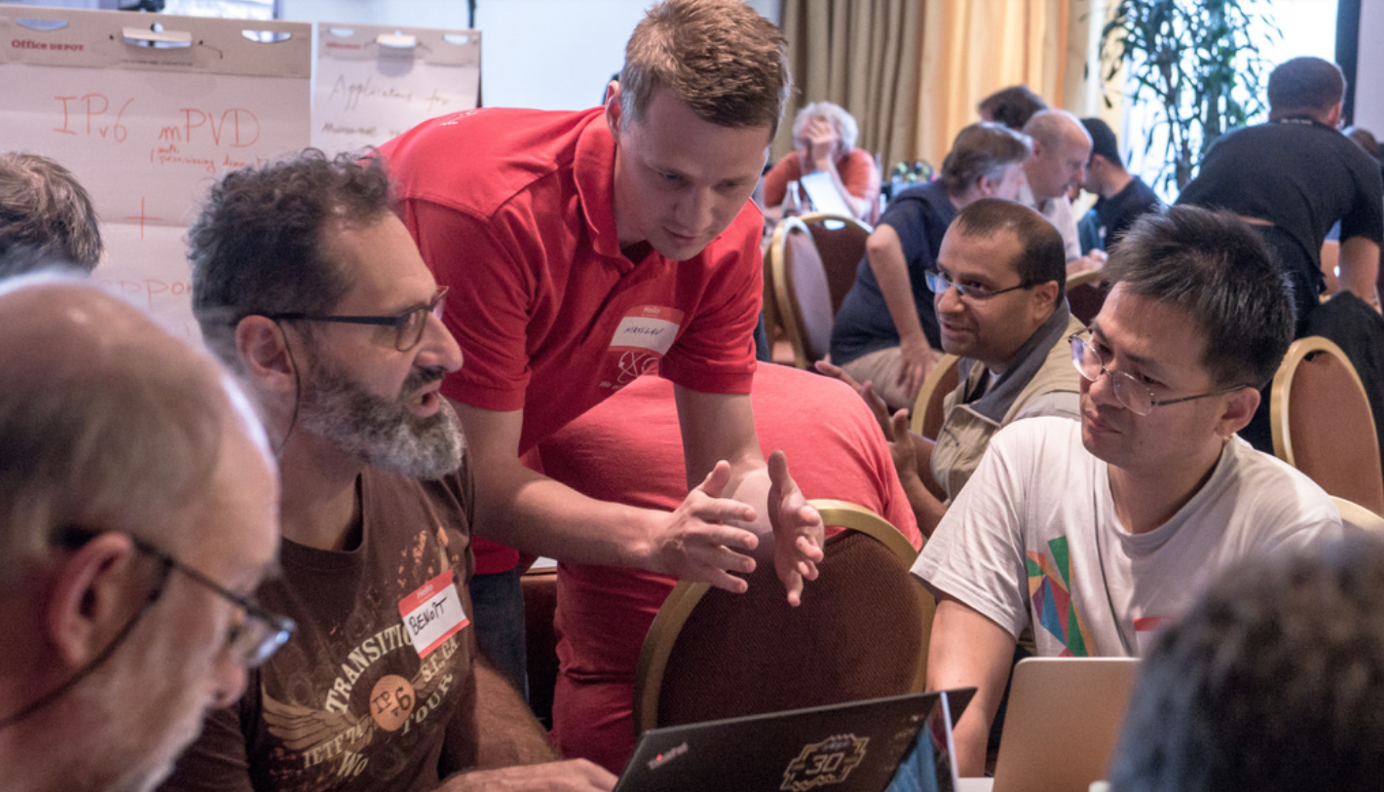
Goals
Collaborate and Learn
Running Code (RFC 6982)
Speed/Relevance of Standards
Feedback to Working Groups
Grow IETF Community

Slide 3
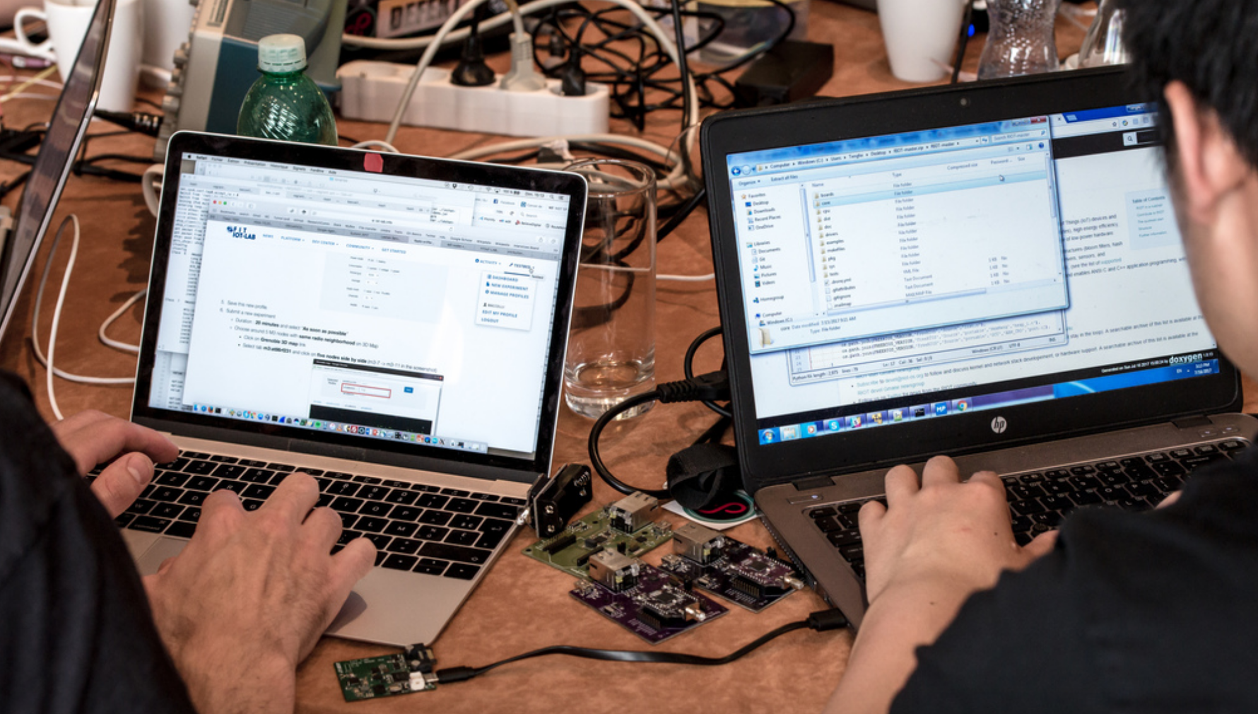
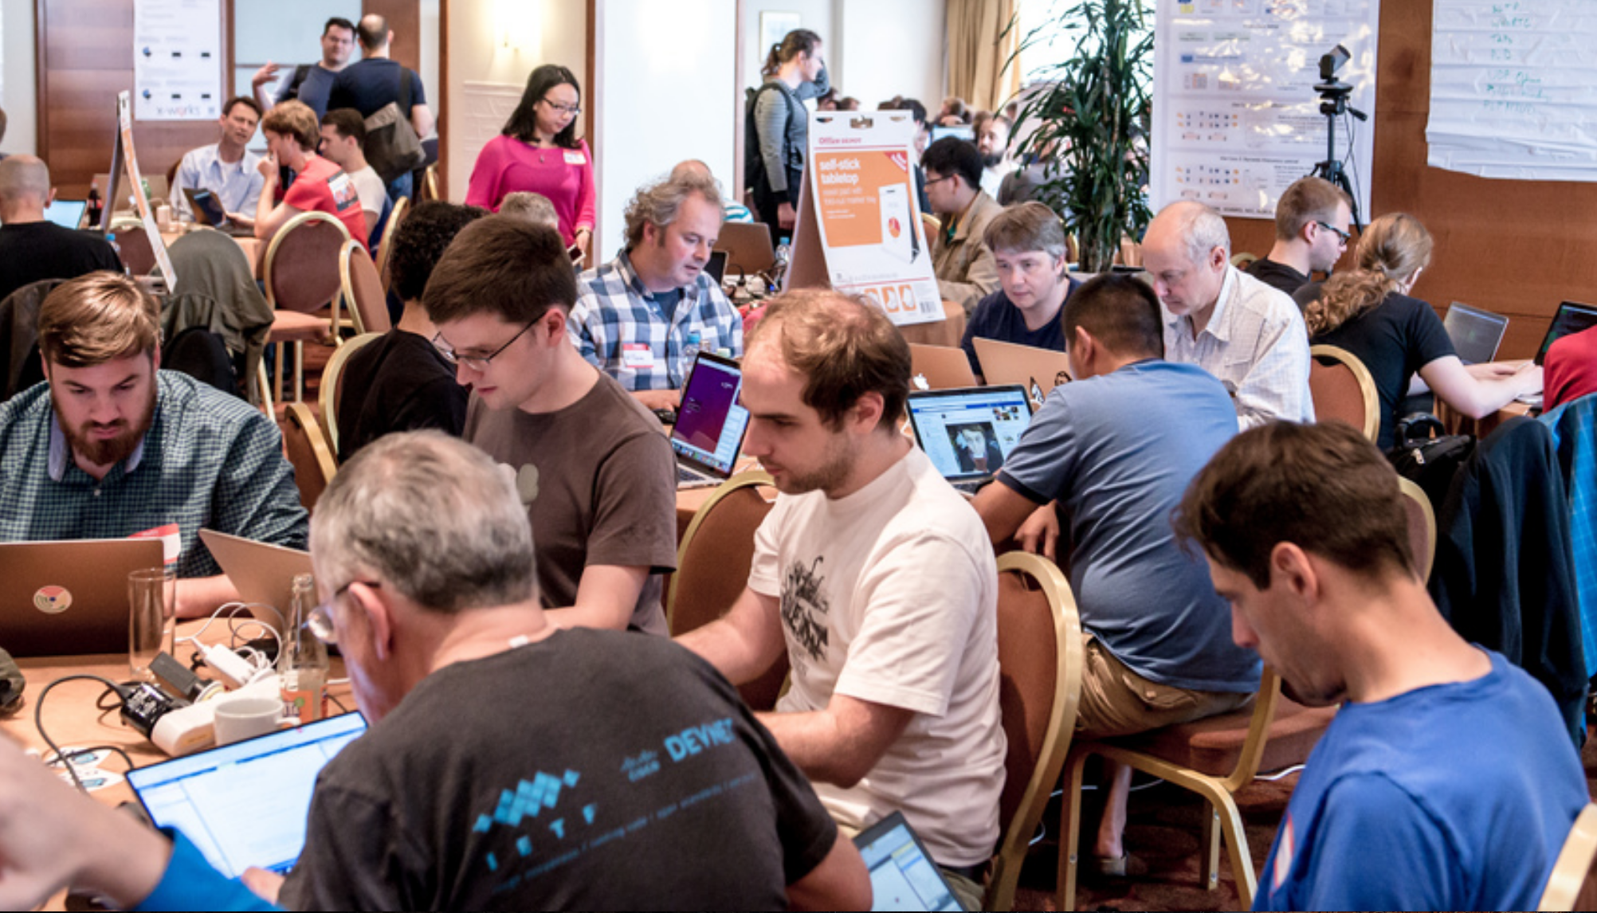
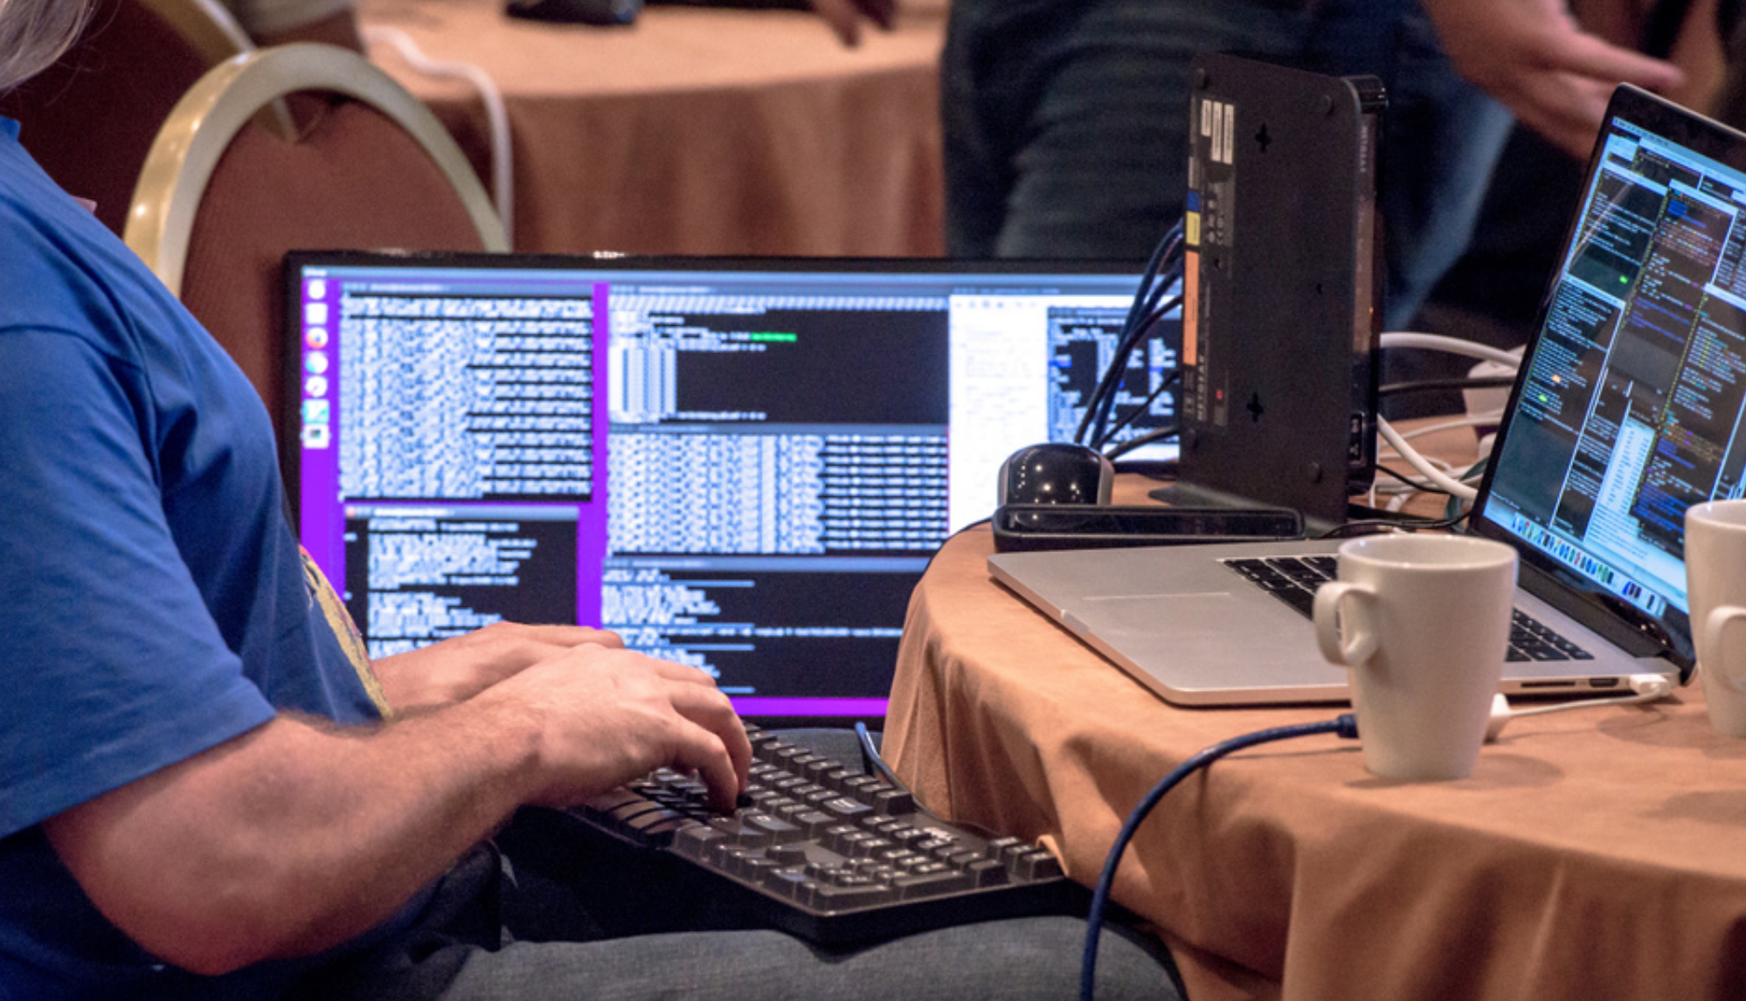
Stats
8th Hackathon
199 registered participants *
45 first IETF *
89 first IETF hackathon *
25+ projects *
New Records

Slide 4
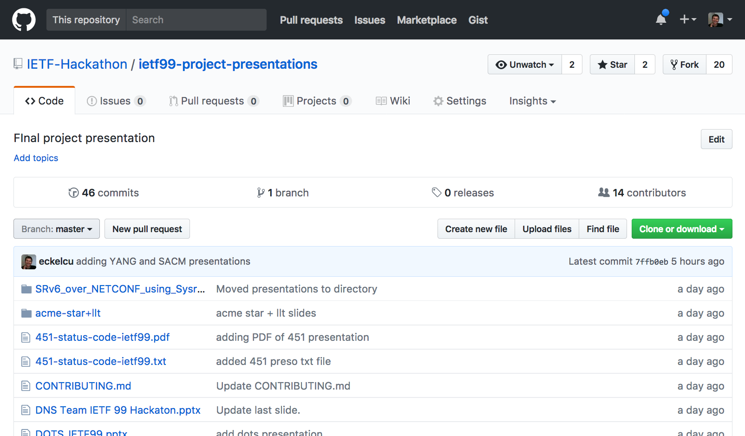
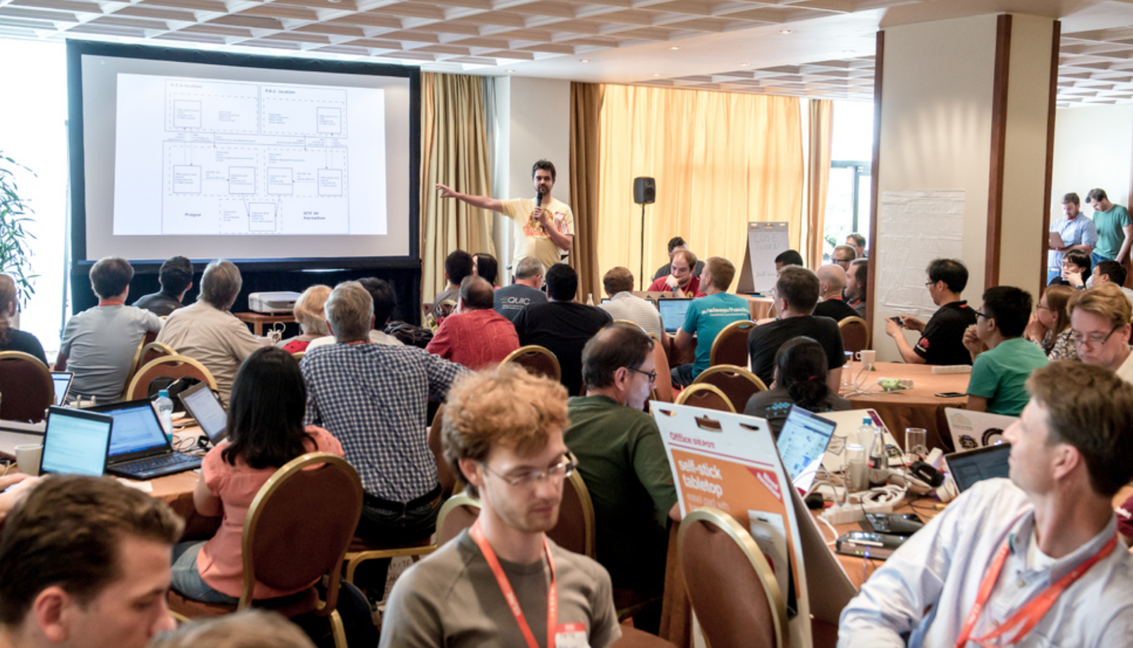
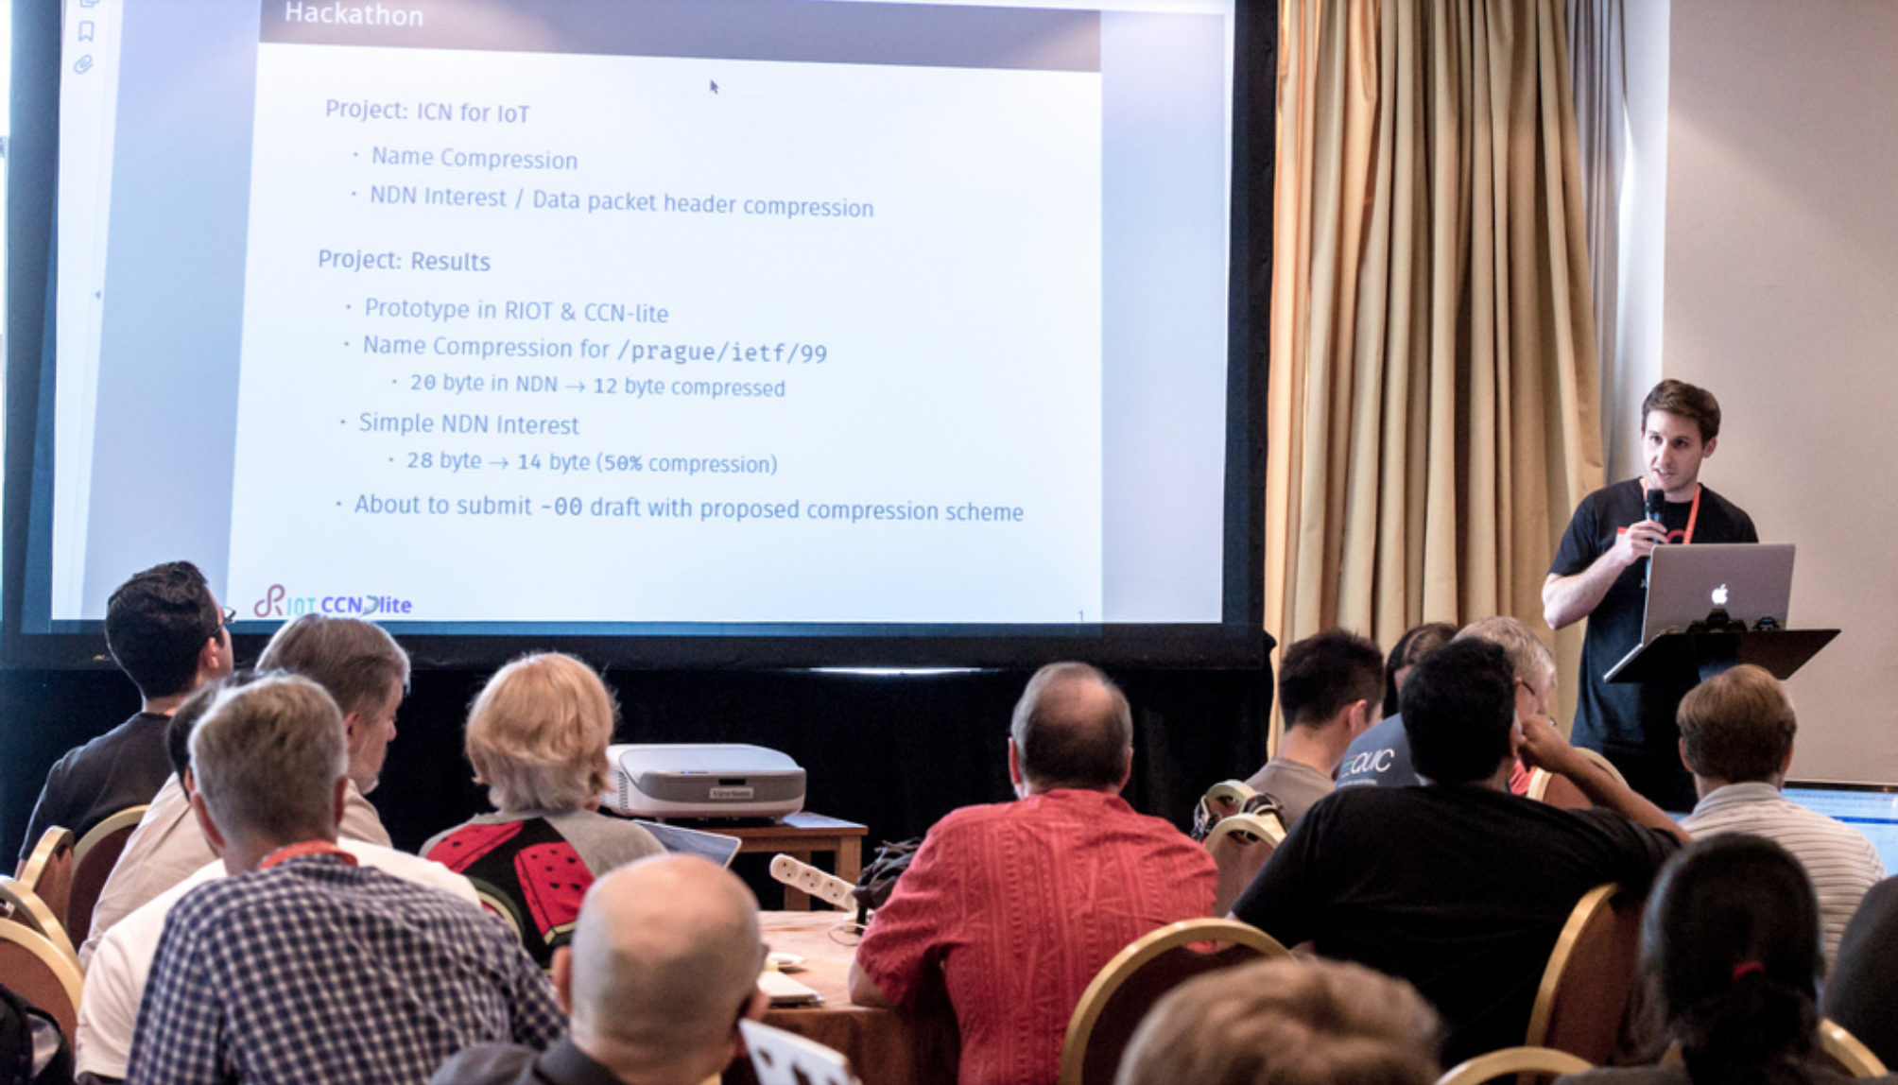
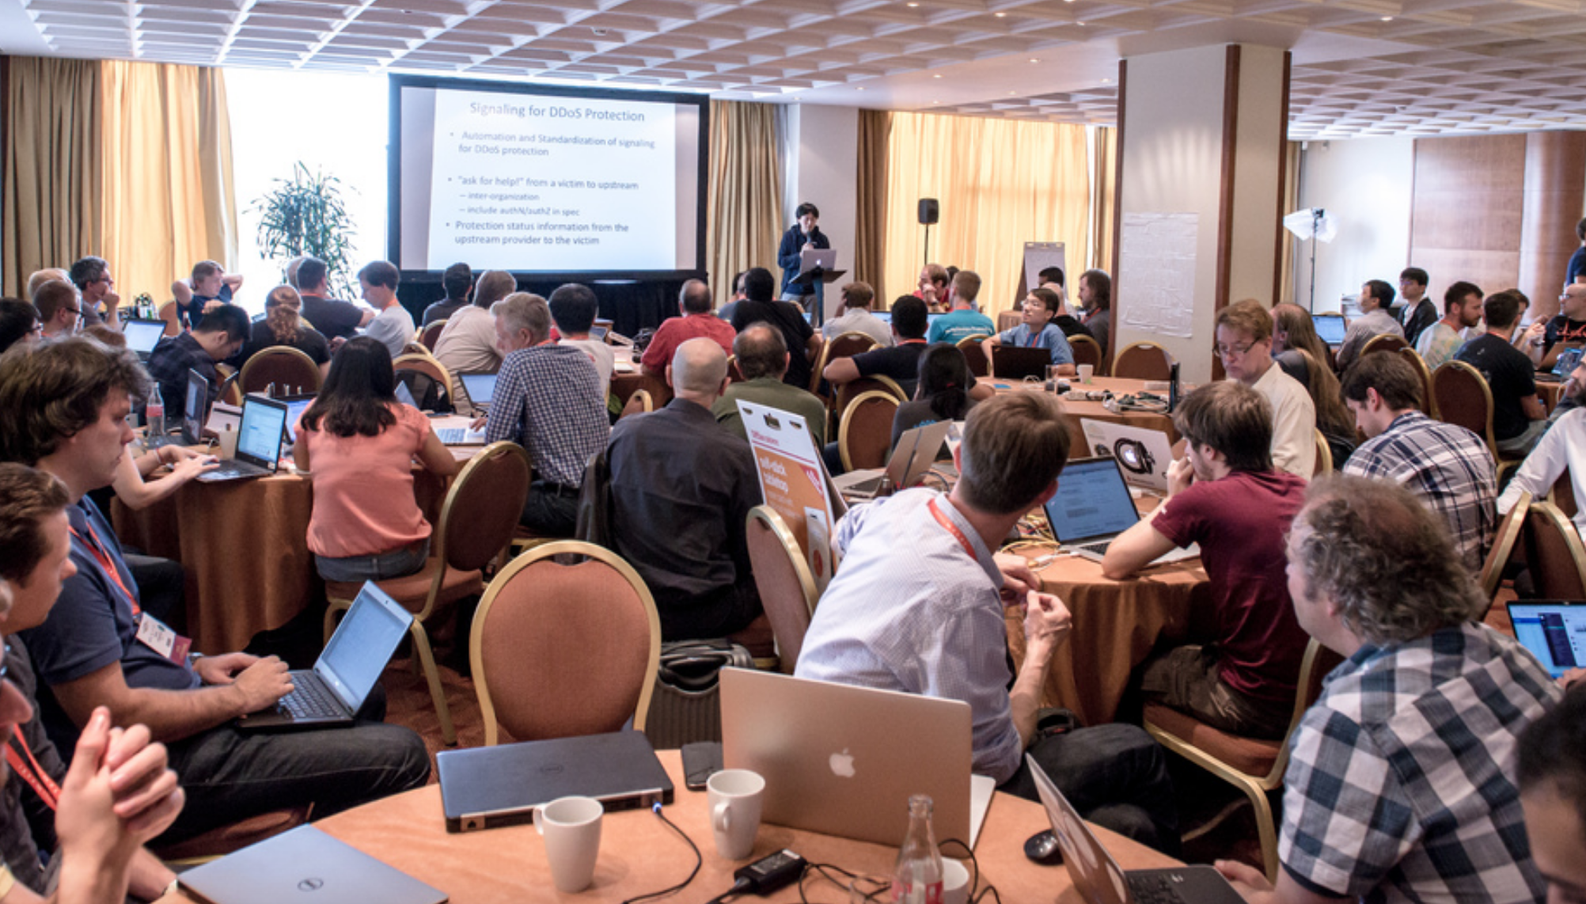
Share Results, Lessons Learned

Slide 5
The Best
New Work - HTTP error code 451
University Work - Interface to Network Security Functions (I2NSF) Framework
“NEAT”est Work - NEAT/TAPS
Interop Work – QUIC
Continuing Work - SCHC implementation and test SCTP
Name - Waiting for go-dots
Overall - SDN Apps for management of microwave radio link via IETF YANG Data Model

Slide 6
Bits-n-Bites Hackathon Demos
NEAT/TAPS
Interface to Network Security Functions (I2NSF) Framework
SDN Apps for management of microwave radio link via IETF YANG
Multicast over SPRING
RIOT
Multiple Provisioning Domains (mPvD) and Captive Portal detection
Go implementation of DOTS

Slide 7

IETF 100 Hackathon Singapore, November 11-12
Sponsors
welcome!

